Slide 1
Hennepin County
Midterm Presentation
March 6th, 2020
Team O: Chia Hsuan Chava Chou, Brady Engelke, Yidan Gao, Minya Na, William Wu
Team P: Samira Arondekar, Maya Carnie, Mona Tai Hsuan Kan, Sho Mishra, Chuchen Leo Xiong

Slide 2

Agenda
Project Overview
Client Technical Needs
Why Neo4j?
Data Overview
Database Design
Data Pipeline
Disparity Analysis
Phase II Roadmap
Questions
Notes:
go back to the whole agenda after finishing each point
how ease the query is, how the logic will help, convince before the demo
*big pic: community wellbeing -> disparity analysis
*difficulty: e.g. how hard to get data sources e.g. technical skills set
Stuff is loosely connected
Roadmap of the ppt

Slide 3
Goal and Phases
Project Overview
Goal: How can we leverage a centralized database to reduce the disparities in Hennepin County?
Phase I: Building the Database
Select the Ideal Database
Collect Open Source Data
Build the Database
Phase II: Identifying Factors Influencing Disparity
SNAP Penetration
HDI Prediction
Notes:
Hennepin County has a responsibility to ensure the livelihood of its constituents.
One of the best ways to do that is to find and address disparities, finding where people maybe aren’t getting what they need and addressing their concerns.
In order to find those disparities we need a lot of data, and we need tools to process them.
We want to know how we can leverage a centralized database to reduce the disparities in Hennepin County.
In the first phase of the project, we built our database.
We needed to understand what issues you faced with the current system, and what systems are out there that we could possibly find to address them.
The database tool we identified needed to be fast, flexible, capable of seamlessly migrating data and running highly efficient queries to dig through the data and find actionable insights.
Once we had our database, we needed to fill that database with data.
You’ve given us 7 domains for which we should focus our data collection.
We needed to understand the complexities that lay within and understand how those factors interact on a tract and racial level.
Fortunately, we’ve accomplished both these tasks, and we’ll show you our progress through the rest of this presentation. So let’s start by addressing your key pain points
Select the Ideal Database

Slide 4
2. Client Technical Needs
There are 3 Major Issues that make a Traditional RDBMS Unsuitable for this Project
01
Schema Flexibility
RDBMS handles granularities poorly
02
Data Migration
RDBMS breaks when you add new data
03
Domain Integration
RDBMS are siloed with little interaction
Notes:
Between our conversations with you, we identified three key aspects that make using the current RDBMS systems difficult
The first one is
Schema Flexibility
The RDBMS system is has difficulties handling datasets of different granularities. For example, if we have ACT Data by school districts and school enrollment by census tract, the way the RDBMS system handles joins makes it difficult to run an analysis on it. Census tracts and the school districts are of different sizes and shapes, and sometimes overlap, which makes incredibly difficult to merge in the traditional system.
This makes Data Migration a headache inducing challenge.
If you want to add new data, you’d have to break down current system and rebuild a new one from scratch, costing valuable resources and time
Because of those two issues that we can’t really integrate the domains that well. The issues in the 7 domains are not limited internally; they interact and create bigger problems that we don’t see if we have the data siloed. We have many different datasets beyond the school ones across the 7 domains, all with their own granularity issues. If we want to run an analysis on anything crossing domains, we’d run into the previous issues again.
Fortunately, we’ve found a tool that can help you alleviate these concerns.

Slide 5
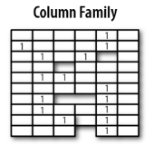
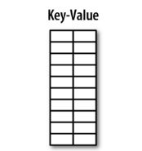
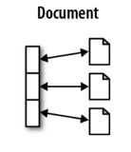
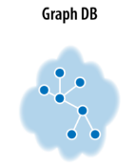
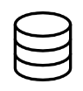


We Recommend Choosing Graph Database out of NoSQL Landscape
3. Why Neo4j?
SQL
NoSQL Landscape
Traditional Database
Project Requirements
Schema Flexibility
Data Migration
Domain Integration
Notes:
As Will mentioned, there are three major issues that RDBMS cannot work well. Lets see other options in NoSQL DB
Flexibility
NoSQL DB (have education data ACT score > can add new dataset school enrollment as columns)
Migration
RDBMS / column: query by joining many table > take much time (query across domains)
Key-value: Can’t filter on value fields (filter HDI by certain threshold)
Integration
have a complex relationship network that help us query and analyze data across seven domains and county, district, census tract level
(ACT score at school district level and income at census tract level, interest in relations across domains and geographical level)
RDBMS: need to specify the name and type of each column. adding new column > need to rebuild a new schema
RDBMS / column: query by joining many table > take much time
(query across domains)
*link back to the first page William’s main points - what is HC’s context
e.g. the schema is not flexible->see, in this plot we mark X.
e.g. query efficiency -> tech presentation example, how 2 lines of Cypher can handle a complex problem (USE STORY)

Slide 6


Of the Available Options, Neo4j is the strongest Graph Database
3. Why Neo4j?
Product
Compatibility with Other Programming Language
Scalability
Ease of Programming
Community Resources
Graph Algorithm
Notes:
Cosmos DB (Microsoft Azure service)
Neo4j (most commonly used open source graph database)
Programming Language: Python / R (inject data, query, do analysis)
Scalability (both have data center in the US, 5/10 years when we collect more data, we can deploy the database in the cloud)
BUT what only Neo4j can handle -> Create the pain point -> how Neo4j can handle

Slide 7
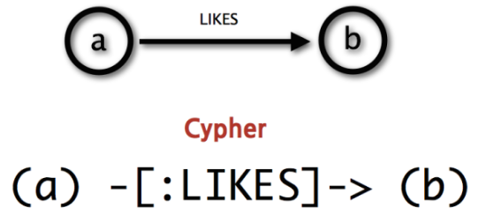
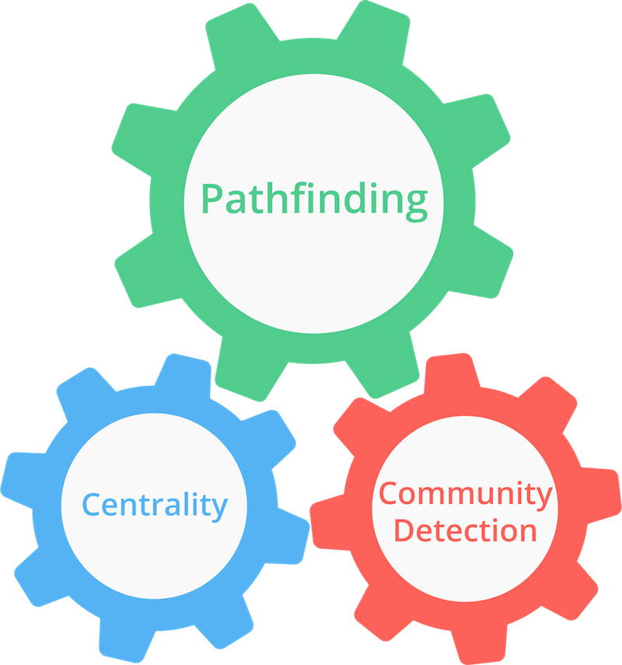

Neo4J Offers Ease of Programming, Rich Community Resources, and Built-in Algorithm
3. Why Neo4j?
Ease of Programming
Community Resources
Graph Algorithm
Intuitive programming language
Easy to learn
Complex queries
Open source
Rich online resources and tutorials
Community detection
Graph similarity algorithms
PageRank algorithm
Notes:
ease of programming: deep and complex query
Community: Open source / GraphAcademy (from how to install neo4j, do query, do graph algorithm, visualization), demo, use cases in every industry (include government) > useful for domain analysis
built in graph algorithm: community detection (we may think tract A and tract B are similar based on population and racial distribution, but based on data from 7 domains this algorithm may tell us that they don’t. > why useful > cluster similar census tracts into group, in a certain group, if one policy or program works well, it may also work well in other census tracts in the same group.)

Slide 8
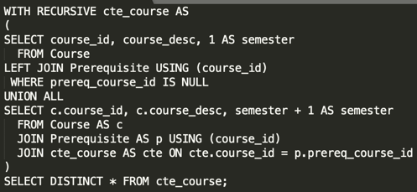
SQL vs Neo4j (Cypher)
3. Why Neo4j?
Find the prerequisites of courses

Slide 9
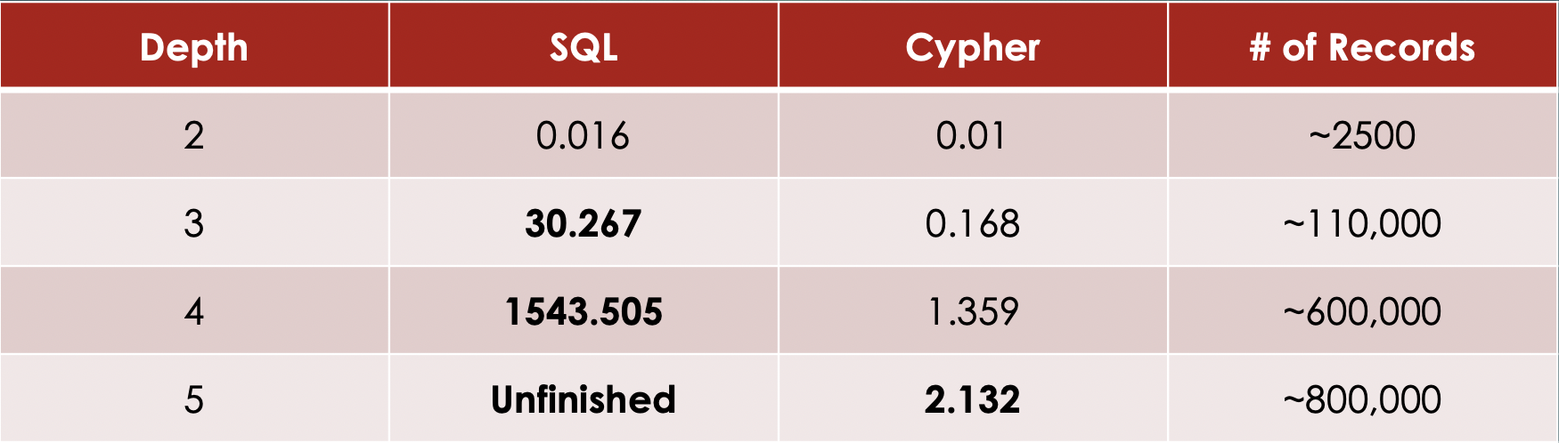
SQL vs Neo4j (Cypher)
3. Why Neo4j?
For a social network containing a million people, with approx. 50 friends each, find me friends-of-friends of depths 2, 3, 4, & 5

Slide 10
To test capability of Neo4j, we need data from 7 domains with different granularity
4. Data Overview
County
Justice*: Attorney dashboard
Demographics
Aggregated data from lower hierarchy
School District
Tract
Education
ACT Score
Employment | Income | Education
Work force, Unemployment, occupation | Income below poverty, household information | Education attainment
Health | Transportation | Housing | Others
Insurance, Life expectancy | Travel time to work | Occupancy by Owned & Rented | Demographic, SNAP information
* Justice data is pending import
Notes:
Need data from different granularity: Education
Need data from 7 domains to analyze the interconnection and disparities across these areas
For second phase analysis, we also include SNAP data and HDI related attributes
In this slide we put some example attributes for you reference, and we will provide the technical transfer document later that includes all attributes, collection process using API.
Next, we will introduce our database design and demo using some practical cases

Slide 11
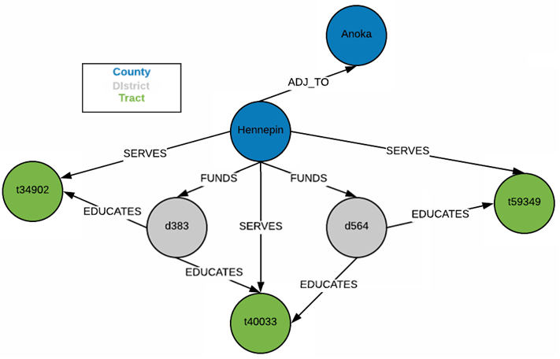
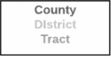
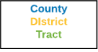
Neo4j Graph Designs Are More Intuitive Than ERDs
5. Database Design
Open Source Data
Neo4j Graph Database
County
Name
Population
Racial Distribution
District
Name
Average ACT
Student population
Census Tract
Name
Average income
Health insured percentage
* Refer to Technical Document for all nodes and attributes

Slide 12
Neo4j Doesn’t Concern Itself with Normalization
5. Database Design
Operation
Create all district nodes
Create
county to district
relationships
Create district to tract relationships
Code
LOAD CSV WITH HEADERS FROM "file:///district.csv" AS line
CREATE (:District {districtId: line.districtId, name: line.name,
student_pop: toInteger(line.student_pop), avg_eng: toInteger(line.avg_eng), avg_read: toInteger(line.avg_read), avg_sci: toInteger(line.avg_sci),avg_ACT:toInteger(line.avg_ACT)})
MATCH (c:County), (d:District)
WHERE c.name = 'hennepin'
MERGE (c)-[:FUNDS]->(d)
LOAD CSV WITH HEADERS FROM 'file:///districts_to_tracts.csv' AS line
WITH line.districtId as district, line.name as name
MERGE (d:District {districtId:district})
MERGE (t:Tract {name:name})
MERGE (d)-[:EDUCATES]->(t)
District
County
FUNDS
District
District
EDUCATES
Tract
Notes:
Normalization and 3rd normal form is not a consideration of a graph database. 3NF is sometimes remembered as “the key, the whole key, and nothing but the key”

Slide 13
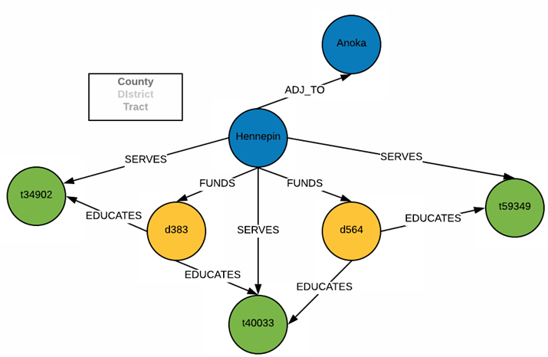
Neo4j Graph Designs Are More Intuitive Than ERDs
5. Database Design
Open Source Data
Neo4j Graph Database
County
County
Name
Population
Racial Distribution
Name
Population
Racial Distribution
District
Name
Average ACT
Student population
Census Tract
Name
Average income
Health insured percentage
* Refer to Technical Document for all nodes and attributes
Notes:
logic of query
granularity
delete / update query

Slide 14



Python & R Seamlessly Connect to Neo4j
6. Data Pipeline
Utility
Import data into graph
CRUD Operations
Create constraints & indices
Visualize query results in a graph
Utility
Connect to a Neo4j graph
Extract tables from graph via Cypher queries
Data analysis
Create visualizations & dashboard layout
Utility
Host custom dashboard
Enable users to interact with dashboard
* Refer to Technical Document for detailed explanation of demo architecture
Notes:
Our IT department has Power BI turned off. Thus, we went with plotly

Slide 15
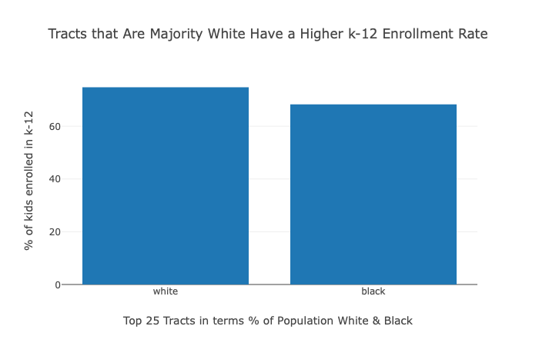
Do minority dominant neighborhoods have a dispropriate school enrollment rate?
7. Disparity Analysis
Cypher Query:
MATCH (d:District)-[:EDUCATES]->(t:Tract)
WHERE t.black_perc > 30
RETURN t.name AS tract, t.black_perc AS prop_black, t.k_12_enrolled_perc AS perc_enrolled_k_12, d.avg_ACT AS avg_ACT
ORDER BY t.black_perc DESC LIMIT 25
Notes:
logic of query
granularity
delete / update query

Slide 16
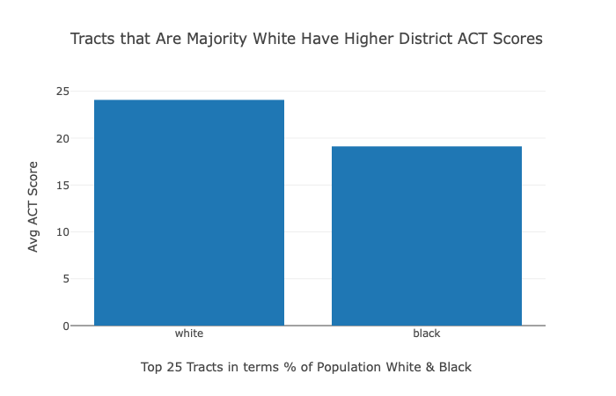
What is the avg ACT score of the districts that educate these tracts?
7. Disparity Analysis
Cypher Query:
MATCH (d:District)-[:EDUCATES]->(t:Tract) WHERE t.black_perc > 30
RETURN t.name AS tract, t.black_perc AS prop_black, t.k_12_enrolled_perc AS perc_enrolled_k_12, d.avg_ACT AS avg_ACT
ORDER BY t.black_perc DESC
LIMIT 25
Notes:
logic of query
granularity
delete / update query

Slide 17
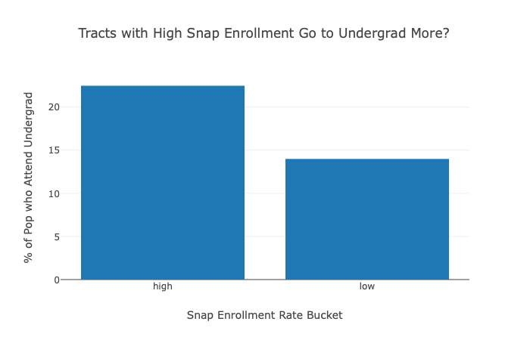
For tracts with high SNAP enrollment vs low SNAP enrollment, what is the percentage of population that attend undergrad?
7. Disparity Analysis
Cypher Query:
MATCH (t:Tract)
WHERE t.households_on_SNAP_perc > 25
RETURN t.name AS tract, t.households_on_SNAP_perc AS households_on_snap_perc, t.college_undergrad_perc AS undergrad_perc
ORDER BY t.households_on_SNAP_perc DESC
Notes:
logic of query
granularity
delete / update query

Slide 18
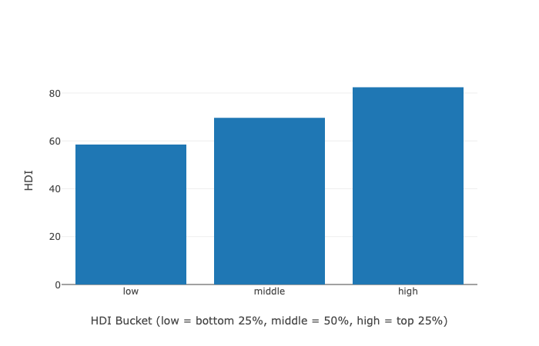
What is the HDI of tracts across Hennepin County?
7. Disparity Analysis
Cypher Query:
MATCH (c:County)-[:SERVES]->(t:Tract)
WHERE c.name = 'hennepin'
RETURN c.life_expectancy AS life_expectancy, t.college_undergrad_perc AS undergrad_perc, t.k_12_enrolled_perc AS k_12_enrollment,
t.income_median AS income_median, t.white_perc AS white_perc, t.black_perc AS black_perc, t.asian_perc AS asian_perc, t.other_ethnicity_perc AS other_perc, t.name AS tract
Notes:
logic of query
granularity
delete / update query

Slide 19
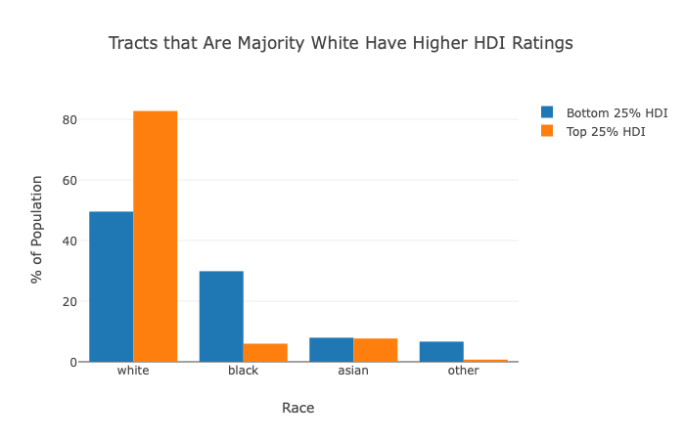
What is the racial distribution of tracts with lowest vs highest HDI?
7. Disparity Analysis
Cypher Query:
MATCH (c:County)-[:SERVES]->(t:Tract)
WHERE c.name = 'hennepin'
RETURN c.life_expectancy AS life_expectancy, t.college_undergrad_perc AS undergrad_perc, t.k_12_enrolled_perc AS k_12_enrollment,
t.income_median AS income_median, t.white_perc AS white_perc, t.black_perc AS black_perc, t.asian_perc AS asian_perc,
t.other_ethnicity_perc AS other_perc, t.name AS tract
Notes:
logic of query
granularity
delete / update query

Slide 20
Q&A
Notes:
phase 2

